Slide 1
EEB C119/219 B
Discussion Week 3
Markov model example

Slide 2
Announcements
Presentations -> today and Thursday
Proposals -> 1 page, by Friday midnight
Extra office hours?
I’m leaving town March 17th (your final projects are due on the 21st)

Slide 3
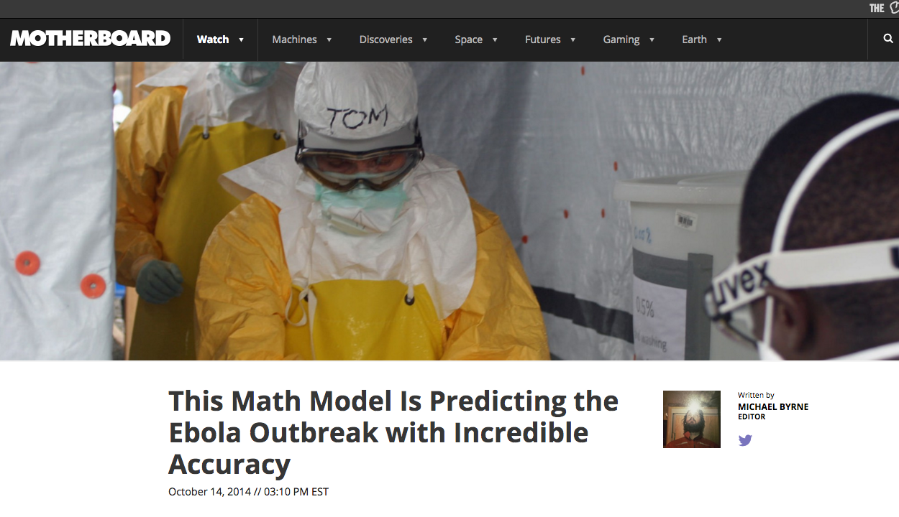
How NOT to use models
VICE - http://motherboard.vice.com/read/this-math-model-is-predicting-the-ebola-outbreak-with-incredible-accuracy
PLoS One - http://journals.plos.org/plosone/article?id=10.1371/journal.pone.0083622

Slide 4
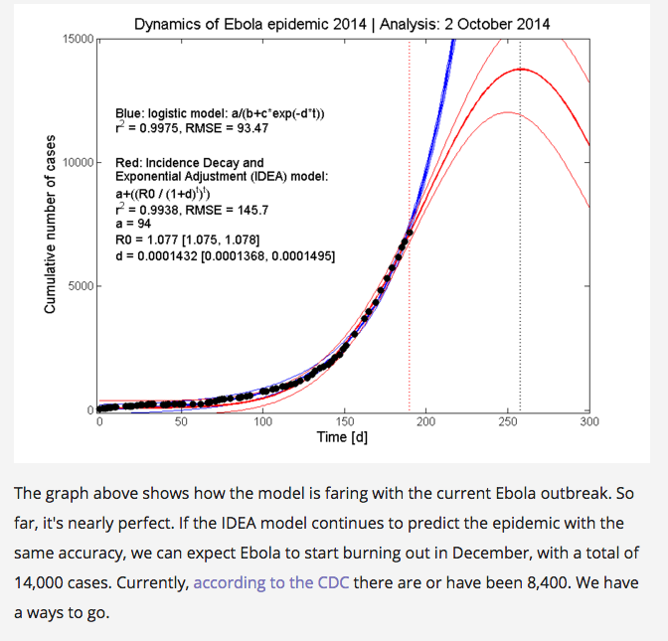
How NOT to use models
VICE - http://motherboard.vice.com/read/this-math-model-is-predicting-the-ebola-outbreak-with-incredible-accuracy
PLoS One –
http://journals.plos.org/plosone/article?id=10.1371/journal.pone.0083622

Slide 5
How to use models right
Mechanism –
What processes in my system are essential/non-essential to the patterns I observe?
e.g. Bacterial competition and space
Sensitivity
Which rates in my system have the strongest influence on the outcomes I’m interested in?
e.g. Sea turtle conservation

Slide 6
How to use models right
Comparison of different conservation/disease control scenarios
Mad cow disease
Control of TB resistance
Identifying “alternate stable states”
E.g. budworm system
E.g. Runjan’s coral reef thesis

Slide 7
Today - How to use models right
Mechanism –
What processes in my system are essential/non-essential to the patterns I observe?
e.g. Bacterial competition and space

Slide 8
Mechanism example: Spatial organization changes the game in Rock – Paper – Scissors competition
S
(Colicin sensitive,
Highest growth rt.)
C outcompetes S
because colicin kills S
S outcompetes R with the highest growth rate
C
(Colicin producing,
Slowest growth rt.)
R
(Colicin resistant
Moderate growth rt.)
R outcompetes C with a higher growth rate
Kerr, B., Riley, M., Feldman, M. & Bohannan, B. Nature (2002)
Based on work by:
Durrett, R. & Levin, S. Jour. thero. Biology. (1996)
Notes:
…or use the lattice strategy and look to your nearest neighbors.

Slide 9
What should happen if all three phenotypes attempt to coexist?

Slide 10


What should happen if all three phenotypes attempt to coexist?
Start with C, S, R
C rapidly kills all S, leaving only C and R
R gradually outcompetes C, since R has a higher growth rate
a
In a well-mixed population
Resistant strain outcompetes all others
a
a
a
a
a
a
a
a
a
a
a

Slide 11
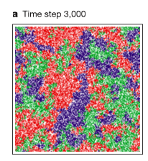
What should happen if all three phenotypes attempt to coexist?
In a well-mixed population
Resistant strain outcompetes all others
But in a spatially-structured population
(Where individuals interact only with their nearest neighbors)
All can coexist by chasing each other around the petri dish.
Durrett, R. & Levin, S. J. Theor. Biol. 185, 165–71 (1997).
Kerr, B., Riley, M. A, Feldman, M. W. & Bohannan, B. J. M. Nature 418, 171–4 (2002).

Slide 12

With spatial structure

Slide 13
What should happen if all three phenotypes attempt to coexist?
In a well-mixed population
Resistant strain outcompetes all others
But in a spatially-structured population
(Where individuals interact only with their nearest neighbors)
All can coexist by chasing each other around the petri dish.
Takeaway: Spatial structure is a pivotal mechanism in this system. Introducing spatial structure into the model qualitatively changes the predicted dynamics.
Durrett, R. & Levin, S. J. Theor. Biol. 185, 165–71 (1997).
Kerr, B., Riley, M. A, Feldman, M. W. & Bohannan, B. J. M. Nature 418, 171–4 (2002).

Slide 14
Differences in model formulation
No spatial structure
Assume population is well-mixed
Model can be deterministic or stochastic
ODE model or Markov chain model
Spatially-structured
Assume heterogeneous mixing
Model is stochastic
Markov chain model
Durrett, R. & Levin, S. J. Theor. Biol. 185, 165–71 (1997).
Kerr, B., Riley, M. A, Feldman, M. W. & Bohannan, B. J. M. Nature 418, 171–4 (2002).

Slide 15
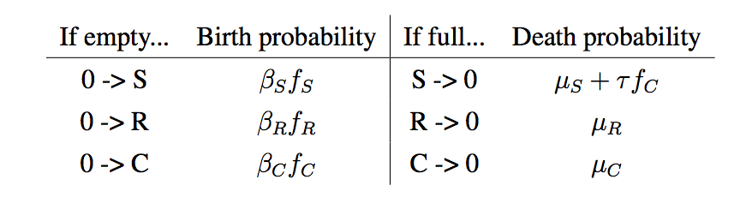
Markov model formulation
R
S
C
0
(Empty)
Durrett, R. & Levin, S. J. Theor. Biol. 185, 165–71 (1997).
Kerr, B., Riley, M. A, Feldman, M. W. & Bohannan, B. J. M. Nature 418, 171–4 (2002).
Notes:
Markov models – path independent, stochastic transition between states

Slide 16

Markov model formulation
Well-mixed:
R
S
C
f_{i} describes the fraction of type i in the WHOLE POPULATION
0
Durrett, R. & Levin, S. J. Theor. Biol. 185, 165–71 (1997).
Kerr, B., Riley, M. A, Feldman, M. W. & Bohannan, B. J. M. Nature 418, 171–4 (2002).
Notes:
Markov models – path independent, stochastic transition between states

Slide 17
Markov model formulation
Spatially structured
R
S
C
f_{i} describes only the fraction of type i surrounding a particular cell of interest
0
Durrett, R. & Levin, S. J. Theor. Biol. 185, 165–71 (1997).
Kerr, B., Riley, M. A, Feldman, M. W. & Bohannan, B. J. M. Nature 418, 171–4 (2002).
Notes:
Markov models – path independent, stochastic transition between states

